Slide 1
Superstore Sales Performance Analysis
Data Storytelling & Statistical Validation
Name : Nalli Divya
Date : 01/03/2026

Slide 2
Business Problem
Despite generating $2.26M in total sales with a healthy 25% profit margin, the company lacks clarity on which regions and product categories are driving profitability and which segments require strategic improvement. The business needs data-driven insights to optimize regional performance and maximize overall revenue growth.

Slide 3
Dataset Overview
Total Sales: $2.26 Million
Total Profit: $565.38 Thousand
Profit Margin: 25%
Total Orders: 4,922
Average Order Value: $459.48
Data covers multiple Regions, Categories, and Years (2015–2018)

Slide 4
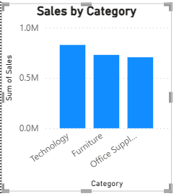
Sales Performance by Category
Technology category generates the highest sales revenue.
Furniture and Office Supplies contribute moderately.
Revenue distribution shows dependency on specific product categories.
Focusing on high-performing categories can further increase profitability.

Slide 5
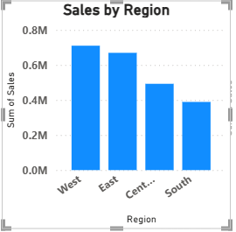
Sales Performance by Region
The West region contributes the highest share of total sales.
The East and Central regions show moderate performance.
Certain regions demonstrate lower revenue contribution.
Regional sales variation indicates potential imbalance in market performance.

Slide 6
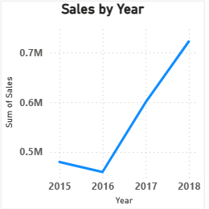
Sales Trend Over Time (2015-2018)
Sales show a consistent upward growth trend from 2015 to 2018.
Year-on-year increase indicates expanding business performance.
No major decline observed during the period.
Growth trend reflects stable demand and operational efficiency.

Slide 7
Key Business Insights
Revenue is primarily driven by the Technology category.
The West region is the strongest contributor to overall sales.
Sales performance has shown steady growth over the years.
Profit margin of 25% indicates healthy business operations.
However, performance differences across regions suggest potential improvement opportunities.
The observed regional variation raises an important question: Are these differences statistically significant?

Slide 8
Hypothesis testing – Regional sales Comparison
Objective:
To determine whether the differences in sales across regions are statistically significant.
Null Hypothesis (H₀):
There is no significant difference in sales across regions.
Alternative Hypothesis (H₁):
There is a significant difference in sales across regions.
Significance Level (α): 0.05

Slide 9
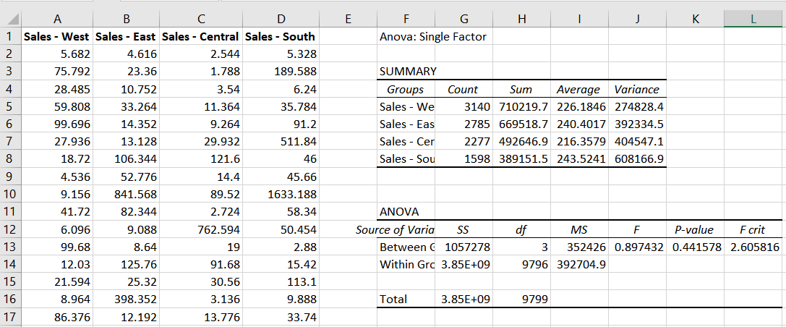
Anova Test – regional Sales Comparison
Objective:
To test whether there is a significant difference in sales across regions.
Test Used:
One-Way ANOVA
Significance Level (α) = 0.05
Key Results:
F-value = 0.8974
P-value = 0.4416
F-critical = 2.6058
Decision:
Since P-value (0.4416) > 0.05,
we fail to reject the null hypothesis.
Conclusion:
There is no statistically significant difference in sales among West, East, Central, and South regions.

Slide 10
Insights
Regional Performance
West, East, Central, and South regions show slight variation in average sales.
However, ANOVA results indicate that the difference is not statistically significant.
This means regional location alone does not strongly impact overall sales performance.
Sales Distribution
Sales are relatively balanced across all regions.
No single region dominates overall revenue significantly.
Performance consistency is observed across markets.
Variability Observation
Within-region sales variability is high.
This suggests factors like product type, pricing, seasonality, or promotions may influence sales more than region.
Statistical Insight
P-value = 0.4416 (> 0.05)
Therefore, we fail to reject the null hypothesis.
Sales differences among regions are not statistically significant.

Slide 11
RECOMMENDATIONS
Uniform Strategy
Since there is no strong regional difference, the company can implement a standardized marketing strategy across all regions.
Focus on Other Factors
Instead of focusing only on region, analyze:
Product categories
Customer segments
Seasonal trends
Promotional campaigns
These may have a stronger impact on sales.
Improve Low-Performing Periods
Identify months or quarters with low sales and introduce targeted campaigns.
Product-Level Optimization
Focus on top-performing products and expand their availability across all regions.

Slide 12
CONCLUSION
The One-Way ANOVA test was conducted to determine whether there is a significant difference in sales among four regions.
The results show that:
P-value (0.4416) is greater than the significance level (0.05).
Therefore, we fail to reject the null hypothesis.
This indicates that there is no statistically significant difference in sales across regions.
Overall, regional location does not appear to be a major factor influencing sales performance. Future strategies should focus on product-level and seasonal analysis rather than geographical differences.

